Slide 1
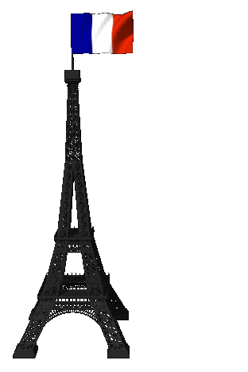
Adverbs Beaucoup, Bien, Un Peu

Slide 2
Adverbs
Adverbs describe verbs, adjectives and other adverbs.
Adverbs tell how much, where, why or when.
Example: I like music a lot.
How much do you like it?
A lot.

Slide 3
Adverbs
3 French Adverbs that describe HOW MUCH are:
Un peu – a little
Bien – really/well enough
Beaucoup – a lot

Slide 4
Adverbs
In French, the
Adverb comes After the verb it describes!
I like rap a lot.
becomes
I like a lot rap.
J’aime beaucoup le rap.

Slide 5
Adverbs
Beaucoup – A LOT
Bien – Really
Un peu – a little

Slide 6
Adverbs
J’aime beaucoup le sandwich.
I like the sandwich a lot.
J’aime bien la musique.
I really like music.
J’aime un peu le jazz.
I like jazz a little.
J’aime un peu écouter le reggae.
I like to listen to reggae a little.
NOTE THE ADVERB COMES AFTER THE VERB IT DESCRIBES!

Slide 7
You try: Write the sentence in French:
I really like to swim.
I swim well.
They (m) like to study a little.

Slide 8
Check your answers
I really like to swim.
J’aime bien nager.
I swim well.
Je nage bien.
They (m) like to study a little.
Ils aiment un peu étudier.

